Slide 1
UNIT 1: INTERPRETATION
1: The Value of Data + Data Narratives
2: Excel Fundamentals
3: Data Referencing
4: Data Aggregation
5: Data Visualization
6: Statistics in Excel*
James Larkin – Data Analytics Instructor
Notes:
* Indicates a FLEX lesson

Slide 2
DATA ANALYSIS & STATISTICS

Slide 3
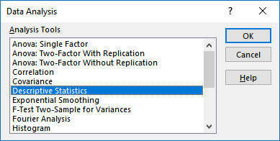
INSTALLING THE ANALYSIS TOOLPAK
To load and activate Excel's Analysis ToolPak:
Go to: File tab, Options, then to the “Add-Ins” category.
In the “Manage” box, select “Excel Add-Ins” and click Go.
If you're using Excel for Mac, go to Tools > Excel Add-Ins in the File menu.
In the Add-Ins box, check the Analysis ToolPak checkbox and click OK.
If the Analysis ToolPak is not listed in the Add-Ins box, click “Browse” to locate it.
If you’re prompted that the Analysis ToolPak is not on your computer, click “Yes” to install it.
Notes:
INSTRUCTOR TALKING POINTS:
It’s worth noting that students will be using the Analysis ToolPak for this lesson, which takes you about as far as you can go with complexity of analysis in Excel.
You’ll see that it might slow your computer down a bit (although execution time on our particular exercise is very fast because we’re only dealing with ~200 rows of data), and give you a hint of why, at a certain point in your analyses, you’ll want to learn other tools like SQL for querying external databases, then Tableau, R, Python for conducting analyses so you can perform actions more quickly.

Slide 4
STATISTICAL ANALYSIS
OPENING

Slide 5
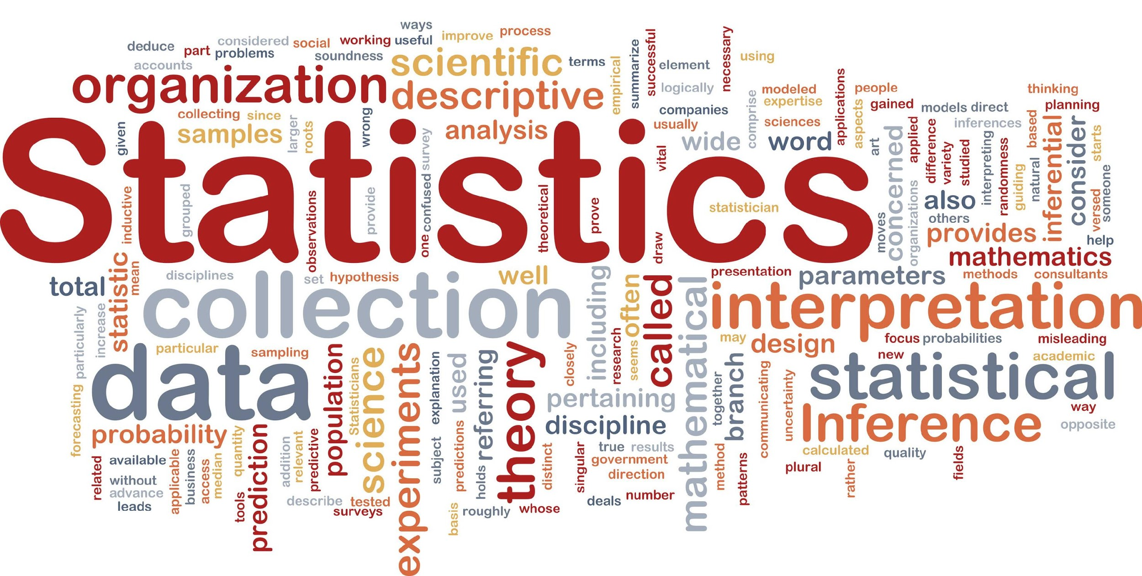
STATISTICAL ANALYSIS
Survey and define different types of statistical analysis.
Demonstrate basic statistical functions in Excel.
Practice applying statistical functions in Excel.

Slide 6
STATISTICS: QUICK DEFINITIONS
"Statistics is the branch of scientific method which deals with the data obtained by counting or measuring the properties of populations of natural phenomena. In this definition 'natural phenomena' includes all the happenings of the external world, human or not." — Professor Maurice Kendall, “The Advanced Theory of Statistics”, 1943
"Statistics is: the fun of finding patterns in data; the pleasure of making discoveries; the import of deep philosophical questions; the power to shed light on important decisions, and the ability to guide decisions in business, science, government, medicine, industry." — Professor David Hand, President of the Royal Statistical Society, November 2009
*Excellent opportunity to use conditional formatting.
Notes:
INSTRUCTOR TALKING POINT: Feel free to skip over the definitions if students are reasonably familiar with statistics in their line of work.

Slide 7
STATISTICAL ANALYSIS: THE “WHY” BEHIND THE “WHAT”
Reports often review the statistics of what happened. Analytics tends to focus on why things happened.
So what is statistical analysis?
Selecting models to validate hypotheses and test assumptions.
Determining relationships between variables.
Assessing data trends and trajectories.
Identifying patterns and groupings.
Detecting mistakes and outliers.*
*Excellent opportunity to use conditional formatting.

Slide 8
STATISTICAL ANALYSIS
Pair up and take five minutes to share the following:
How do you define statistics? (Be specific.)
Describe a decision you made that was informed by statistical information or analysis.
Be prepared to share your answers with the class.

Slide 9
STATISTICAL ANALYSIS
INTRODUCTION

Slide 10
STATISTICAL ANALYSIS: BRANCHES OF STATISTICS
Descriptive statistics: Describe all the data on hand.
Examples: average, mean, median, central tendencies, and dispersion.
Precise results: e.g., average selling price of a stock during this quarter.
Inferential statistics: Use a data sample to “make inferences.”
Examples: regression, correlation, and estimating true population average.
Approximate results: e.g. use a series of price-to-earnings ratios for a stock to estimate future earnings within a confidence interval.
Uses sample data to draw reasonable conclusions about a larger population.

Slide 11
STATISTICAL ANALYSIS
EXCEL’S STATISTICAL
FUNCTIONS

Slide 12
STATISTICAL ANALYSIS: MEASURES
Measures of Description: Sum, totals (discrete/bins), time series (continuous), distributions, and count.
Measures of Location: Mean (average), median, mode, min, and max.
Measures of Dispersion: Range, frequency, variance, standard deviation, skew, and symmetry.
Measures of Association (Inference): Correlation, covariance, regression, trend, and forecast.
Notes:
INSTRUCTOR TALKING POINTS: Identifying patterns, groups and associations

Slide 13
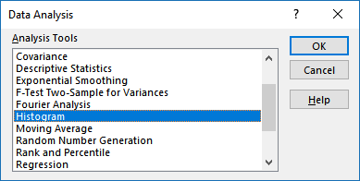
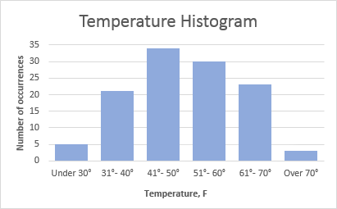
STATISTICAL ANALYSIS: EXCEL FUNCTIONS
Measures of Description:
Sum ( )
Totals
Distributions (discrete/bins)
Time series (continuous)
Count ( )
Notes:
INSTRUCTOR TALKING POINTS: Identifying patterns, groups, and associations. Emphasis placed on creating correct and appropriate bins – data is often overlooked or distorted by incorrect binning.

Slide 14
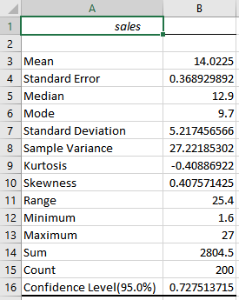
STATISTICAL ANALYSIS: EXCEL FUNCTIONS
Measures of Location:
Mean (AVERAGE)
Median (MEDIAN)
Mode (MODE)
Min(MIN)
Max (MAX)
Excel’s descriptive statistics
Notes:
INSTRUCTOR TALKING POINTS: Identifying patterns, groups and associations

Slide 15
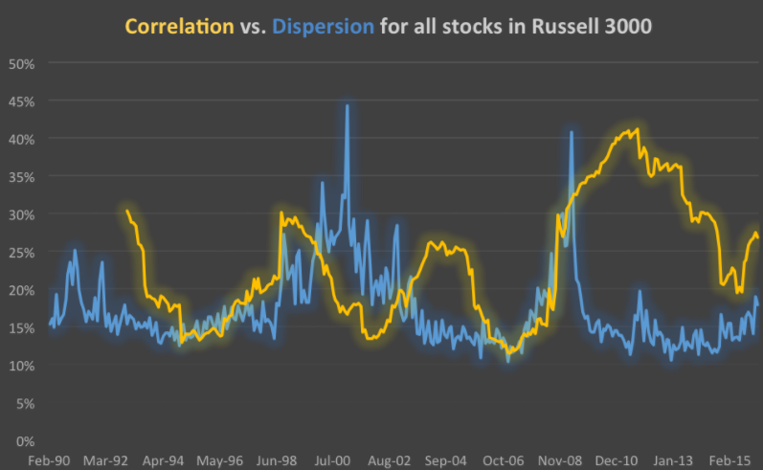
STATISTICAL ANALYSIS: EXCEL FUNCTIONS
Measures of Dispersion:
Range
Frequency
Variance
Standard deviation
Skew and symmetry
Source: https://goo.gl/MiuMQw
Notes:
INSTRUCTOR TALKING POINTS: Identifying patterns, groups, and associations.
Graphic from 2016 stock analysis demonstrating that “dispersion was on the rise” and discussing stock selection using the two key metrics of dispersion and correlation between U.S. equities.
There are a few different ways to measure dispersion, but all of them point to the same trend. Dispersion among equities is increasing – it has grown by 65 percent since December of 2012, when it was only at 11 percent, a multi-year low for the metric. As of last month, the spread between average outperforming and the average underperforming stock in the Russell 3000 hit 18 percentage points (for returns measured over 1 rolling month). Intuitively, this is important for managers practicing a long/short strategy – they want the “good” stocks to outperform the “bad,” and the magnitude matters because it directly translates into returns when they get it right.

Slide 16
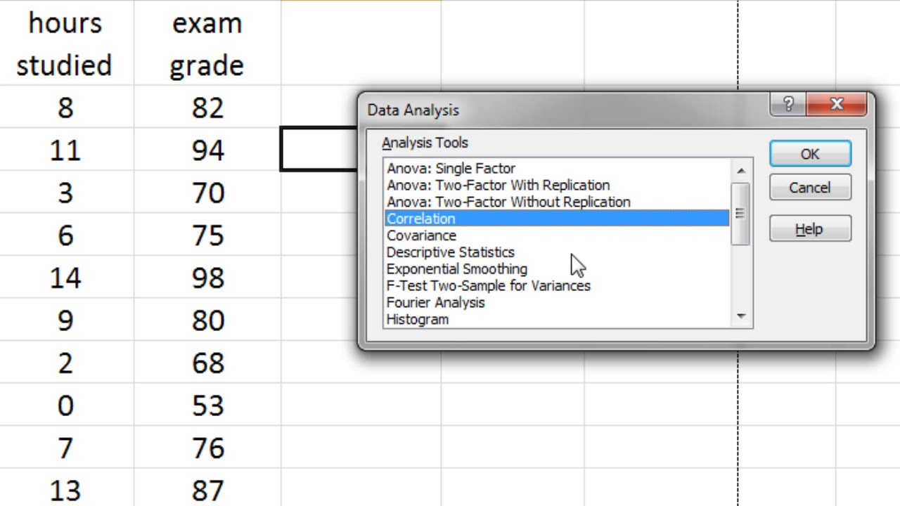
STATISTICAL ANALYSIS: EXCEL FUNCTIONS
Measures of Association (Inference):
Correlation
Covariance
Regression
Trend
Forecast
Notes:
INSTRUCTOR TALKING POINTS: Identifying patterns, groups, and associations.

Slide 17
STATISTICAL ANALYSIS
GUIDED PRACTICE: EXCEL’S STATISTICAL
FUNCTIONS

Slide 18
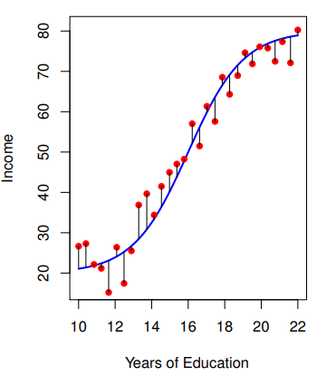
EXCEL FUNCTIONS: REGRESSION ANALYSIS
Here are some typical questions modeled by regression analysis:
How much does salary (y) increase with one more year of education (x)?
How much do profits (y) increase with a 10-unit improvement in product ratings (ex: movie rating websites, such as IMDb)?
Notes:
INSTRUCTOR TALKING POINTS: Mathematically speaking, “how much” equates to a “marginal effect,” which is the impact on y of a one unit change of x.

Slide 19
EXCEL FUNCTIONS: REGRESSION ANALYSIS
Consider a scenario of TV advertising spend and its relationship to sales. The data shows sales in thousands of units sold for TV, radio, and newspaper budgets in each market.
Regression analysis uses the form y = a + bx to quantify and anticipate the relationship between x and y. Like any model, regression has a set of assumptions that must be met for the results to be accurate and meaningful.

Slide 20
EXCEL FUNCTIONS: REGRESSION ANALYSIS
Regression analysis assumptions/requirements include:
The relationship between the y and x variables is approximately linear.
Zero autocorrelation of the error terms.
Homoscedasticity: The error variance is constant.
Little-to-no multicollinearity: There’s no extremely high correlation between predictor variables.
Few, if any, outliers.

Slide 21
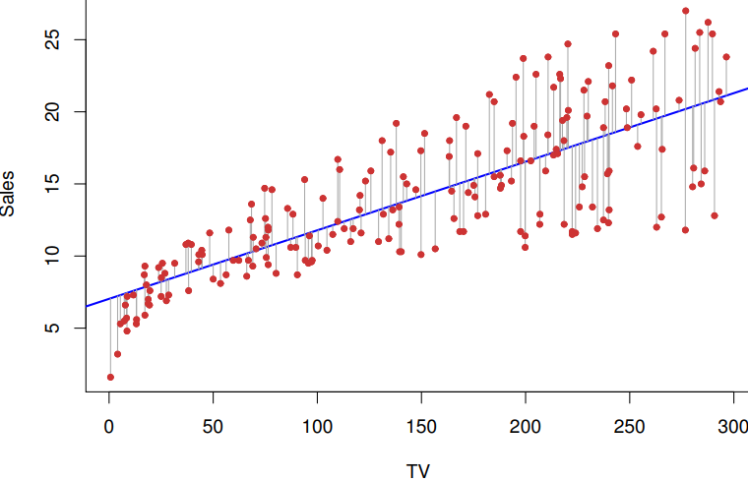
EXCEL FUNCTIONS: REGRESSION ANALYSIS
We’ll begin by regressing TV ad spending with sales.
Sales is the dependent variable y, and TV is the independent variable x.
Notes:
INSTRUCTOR TALKING POINTS: Here we are measuring the impact of TV advertising on sales. Diagram interpretation notes:
Red dots: Represent data on TV investment (x axis) and sales (y axis).
Blue diagonal line represents regression line.
Gray vertical lines connecting each dot to the regression line represent the distance from that data point to the regression line.
The intercept and slope of the line (i.e., Y=a+bX) is what quantifies the relationship for us — b is the marginal effect of X on Y.
Without getting too deep into the technical details, the regression line minimizes the sum of all these squared distances.

Slide 22
EXCEL FUNCTIONS: REGRESSION ANALYSIS
Open the “Advertising.xlsx” workbook.
Once on the “Advertising” tab with the source data, click “Data Ribbon > Data Analysis.”
Select regression:
For the y axis: Select the sales column without the header (E2:E201).
or the x axis: Select the TV data column without the header (B2:B201).
Select New Worksheet.
Select Residual Plots and Line Fit Plots.
Notes:
INSTRUCTOR TALKING POINTS: Instructions for creating a regression analysis using the Data Analysis Toolpak.

Slide 23
STATISTICAL ANALYSIS
INDEPENDENT PRACTICE: STAT FUNCTIONS IN EXCEL

Slide 24
EXCEL FUNCTIONS: REGRESSION ANALYSIS
Open the “Advertising.xlsx” workbook.
Complete the BASE tab instructions.
Discuss your findings in breakout groups.
Share observations that would affect how the advertising budget should be applied with your breakout group.

Slide 25
STATISTICAL ANALYSIS: P VALUES AND NULL HYPOTHESIS
Inferential statistics hypothesis testing includes:
P value (probability value): The probability of finding the observed, or more extreme, results when the null hypothesis of a study question is true.
Null hypothesis: A test for significant difference between specified populations, with any observed difference being due to sampling or experimental error.
Notes:
INSTRUCTOR TALKING POINTS: Additional reference information for Inferential Statistics.

Slide 26
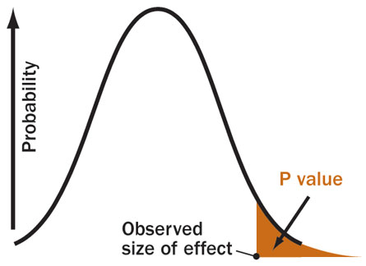
STATISTICAL ANALYSIS: P VALUES AND NULL HYPOTHESIS
Notes:
INSTRUCTOR TALKING POINTS: Additional reference information for Inferential Statistics.

Slide 27
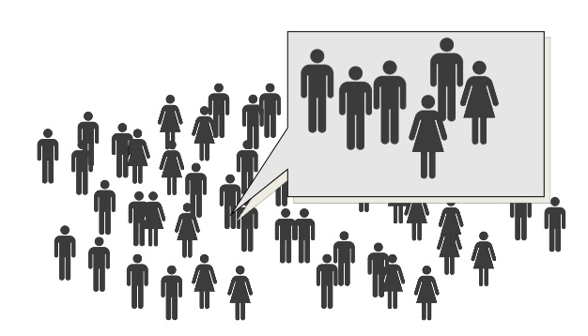
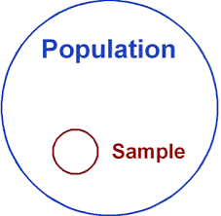
STATISTICAL ANALYSIS: SAMPLING THEORY
Probability sampling selects a representative subset of a population.
Random: Each individual has a likely chance of being selected.
Stratified: Random sampling with a population’s known segments.
Sampling errors arise from chance or random selection. Sample bias (constant error) is typically due to inadequate design.
Notes:
INSTRUCTOR TALKING POINTS: Additional reference information for inferential statistics.

Slide 28
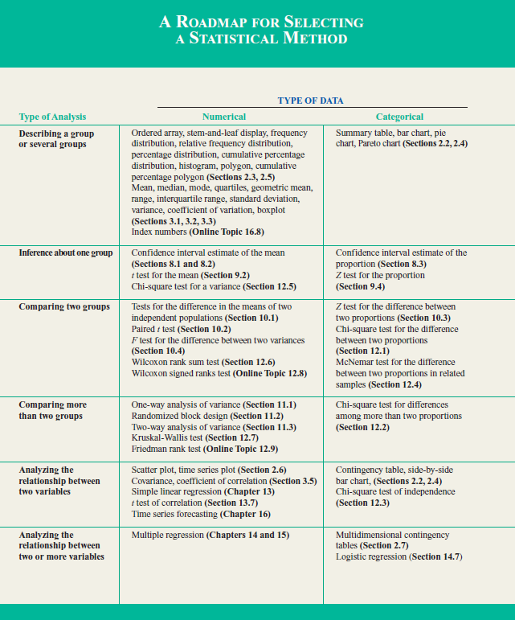
STATISTICAL ANALYSIS: ROADMAP
Use these two key questions to identify the right tool for the analysis task:
1) Is your data numerical or
categorical?
2) What is your goal?
Source: Basic Business Statistics, see student resources for copy.
(See GA’s Unit 1 recap guide for a bigger version of this chart.)
Notes:
INSTRUCTOR TALKING POINTS: Which statistical tool is right for the task?

Slide 29
STATISTICAL ANALYSIS: ROADMAP
Pair up and take 10 minutes to discuss the following:
Describe a statistical analysis you want to conduct, given today’s lesson.
What’s the goal of the analysis and what type of tests/analyses would you run?
Be prepared to share your answers with the class.

Slide 30
STATISTICAL ANALYSIS
CONCLUSION

Slide 31
WHAT DID WE LEARN?
In today’s lesson, we:
Introduced the role of statistics in data analysis and discussed its importance.
Explored the difference between descriptive and inferential statistics.
Introduced Excel’s Analysis ToolPak and several of its available functions.
Applied statistical functions to sample problems and considered how these outputs might apply to different types of business questions.

Slide 32
STATISTICAL ANALYSIS
Q&A

Slide 33
WHAT’S NEXT?
Unit 1 recap and discussion.
Generate real world takeaways.
Look ahead to SQL in Unit 2.
Finalize work on Project 1: Airbnb.
Present and critique Project 1.

Slide 34
UNIT RECAP
UNIT 1: REVIEW

Slide 35
UNIT 1 RECAP
In Unit 1, we learned how to:
Define methods for thinking about how to solve problems with data, including GA’s data workflow and the five V’s of data.
Apply foundational principles - like color - to successfully visualize and present data.
Explain common strategies for communicating data narratives, including how to: different narrative strategies, focusing on data, anticipating key stakeholder concerns, and selecting visualizations with purpose.
Applied data cleaning techniques and strategies, while NULLs were introduced with four options for preparation.
Demonstrated how to use named ranges.
Introduced and explained the differences between different data referencing techniques in Excel, including VLOOKUP, HLOOKUP, and INDEX / MATCH.
Use aggregate functions, Pivot Tables, and other methods to summarize data.
Explain different types of statistical analysis and demonstrate basic statistical functions in Excel.

Slide 36
UNIT REVIEW
Our Unit 1 Review Guide is available here.
Take a few minutes to look it over.
Note any remaining questions you may have.

Slide 37
UNIT REVIEW
Pair up and take 10 minutes to discuss:
What are some key takeaways from Unit 1?
What you can do to make these takeaways actionable or valuable in your team, organization, or workplace?
Be prepared to share your answers with the other teams!
Notes:
Instructor Prompt: If groups are stuck, here are some thought starter suggestions:
What data projects could they get clarity on?
How do they communicate standards for conducting analyses?
How does their team handle data? (e.g. backups, etc)

Slide 38
STATISTICAL ANALYSIS
RESOURCES

Slide 39
RESOURCES
Using Excel’s Analysis ToolPak Add-In: http://www.nvc.vt.edu/rmajor/bit5724/AnalysisToolPakGuide.pdf
Statistical Analysis Handbook by Dr. M J de Smith (found in your student resource folder)
Basic Business Statistics, Concepts and Applications by Berenson, Levine, Krehbiel. 12th Edition. (Available for free download online: https://goo.gl/N4z2VQ)
An Introduction to Statistical Learning with applications in R: https://goo.gl/6AUuno

Slide 40
STATISTICAL ANALYSIS
EXIT TICKET
DON’T FORGET TO FILL OUT YOUR EXIT TICKET!

Slide 41
STATISTICAL ANALYSIS
CREDITS

Slide 42
CITATIONS
STATISTICAL ANALYSIS
Some of the sample data in this presentation is sourced from "An Introduction to Statistical Learning, with applications in R" (Springer, 2013) with permission from the authors: G. James, D. Witten, T. Hastie, and R. Tibshirani.

